Slide 1
Medication Adherence Tracker for Chronic Patients
CAPSTONE PROJECT
Presented By:
Student Name- SNEHA MITTAL
College Name- University of Delhi
Department – BA (Hons) Political Science
4. AICTE ID- STU6a40e1f387a181782637043

Slide 2
OUTLINE
Problem Statement
Proposed System/Solution
System Development Approach (Technology Used)
Algorithm & Deployment
Result
Conclusion
Future Scope
References

Slide 3
Problem Statement
Chronic disease patients, particularly those living with diabetes, hypertension, and other long-term conditions, often struggle to follow their prescribed medication schedules consistently due to forgetfulness, complex dosing routines, side effects, lack of awareness, or limited support. Missed or incorrect medication doses can lead to poor disease management, worsening symptoms, avoidable complications, and increased healthcare costs. At the same time, caregivers and doctors often have little or no reliable, real-time visibility into a patient's actual medication adherence and must depend on self-reported information, which may be incomplete or inaccurate. Therefore, there is a need for a simple, reliable, and accessible solution that can help patients follow their medication schedules while enabling caregivers and healthcare providers to monitor adherence and intervene promptly when necessary.

Slide 4
Proposed Solution
The proposed solution is Medication Adherence Tracker for Chronic Patients designed to help chronic disease patients, particularly those managing diabetes, hypertension, and other long-term conditions, take their medications correctly and on time. The system will combine medication reminders, adherence tracking, and real-time notifications to support patients while providing caregivers and healthcare providers with meaningful visibility into medication-taking patterns.
Medication Scheduling - Patients can add prescriptions, dosage details, and medication timings to create personalized schedules.
Smart Reminders - Timely notifications remind patients when medications are due, helping reduce forgetfulness and missed doses.
Adherence Tracking - The system records dose confirmations, missed doses, skipped doses, and delays to create an adherence history.
Caregiver & Provider Monitoring - Authorized caregivers and healthcare professionals can view adherence summaries and receive alerts when attention may be needed.
Personalized medication schedules: Supports different medications, dosages, frequencies, and timing requirements.
Automated reminders: Sends alerts through the selected application or notification channel.
Dose confirmation: Allows patients to mark medication as taken, skipped, or postponed.
Missed-dose alerts: Notifies caregivers when predefined conditions are met.
Adherence dashboard: Displays medication history, missed doses, and adherence trends.
Multi-user access: Provides separate interfaces for patients, caregivers, and healthcare providers, subject to authorization.
Secure data management: Protects sensitive health information through authentication, access controls, and secure storage.
Accessibility-focused design: Uses a simple interface, readable text, and clear notifications to support users with varying levels of digital literacy.

Slide 5
System Approach
Item | Spec
OS | Windows 10/11, macOS 12+, Ubuntu 20.04+
Python | 3.10 or higher
Database | SQLite (auto-created, zero config)
Internet | Required only for AI features
Port | 8501 ( Streamlit)
Category | Libraries
UI | streamlit
AI | google-genai
Database | SQLAlchemy, sqlite3
Data & Charts | pandas, plotly
Security | bcrypt
Config | python-dotenv
Date/Time | python-dateutil, datetime
Scheduling | schedule
Image | Pillow
Built-in | json, os/sys, enum, contextlib, collections, hashlib
Software Requirements
Python 3.10+, pip, Git, VS Code/PyCharm, GitHub account, Streamlit Cloud account, any modern browser
Technology used –
Python , Streamlit , Google GenAI SDK (Gemini API) , IBM Bob

Slide 6
Algorithm & Deployment
Algorithm | Type | Where
1 | Adherence Rate Calculation | Statistical / Counting | db_manager.get_adherence_stats()
2 | Threshold-Based Alert | Rule-Based Classification | analytics._render_kpi_metrics()
3 | Sliding Window Trend | Sliding Window | db_manager.get_weekly/monthly_adherence()
4 | Duplicate Dose Detection | Range Query (±30 min) | db_manager.get_existing_log()
5 | Reminder Scheduling & Filtering | Event Scheduling / Time-Window | reminders._ensure_todays_reminders()
6 | bcrypt Password Hashing | Cryptographic (Blowfish) | db_manager.hash_password()
7 | AI Prompt Construction (Multi-turn) | LLM Context Management | ai_engine.chat_with_ai()
8 | Per-Medication Aggregation | Hash Map Grouping | analytics._render_medication_breakdown()
9 | Role-Based Routing (RBAC) | Access Control | app.py main()
DEPLOYMENT –Streamlit based web application hosted on cloud infrastructure for real time access

Slide 7
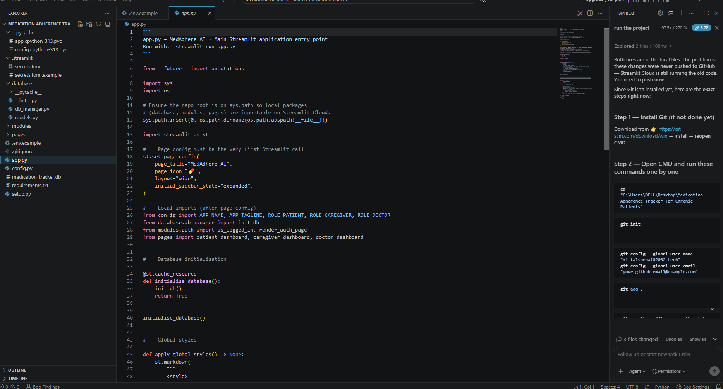
RESULT

Slide 8
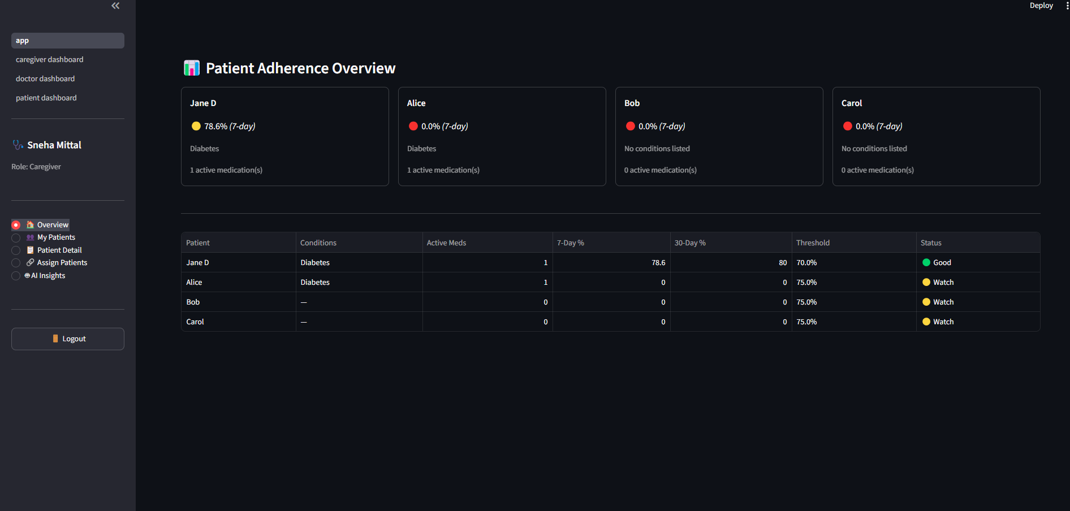
Result

Slide 9
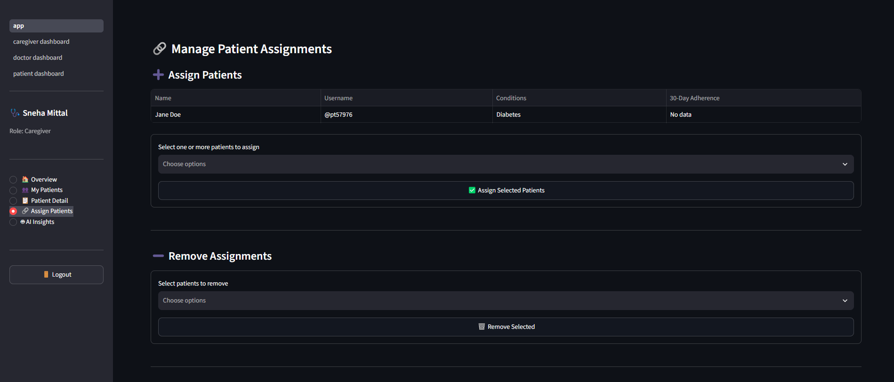
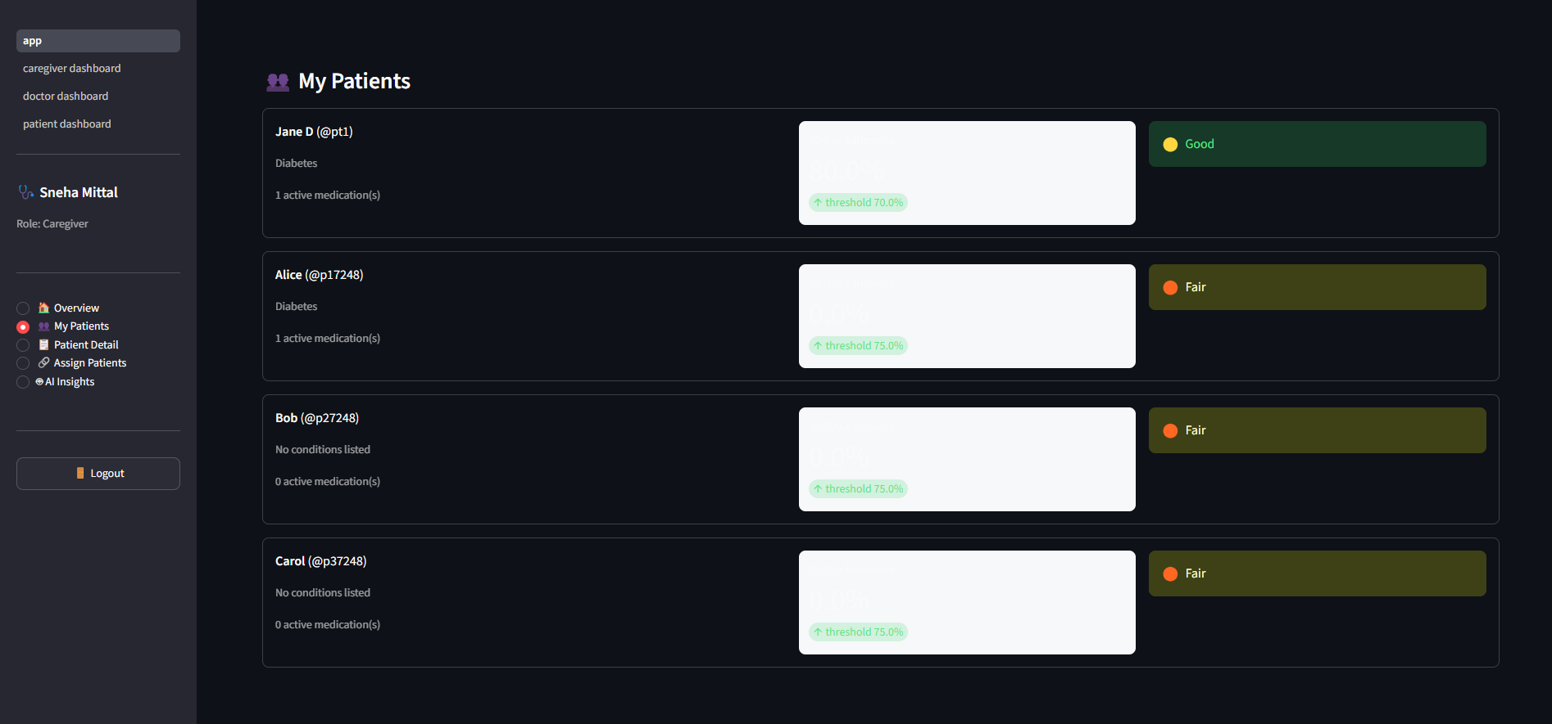
result

Slide 10
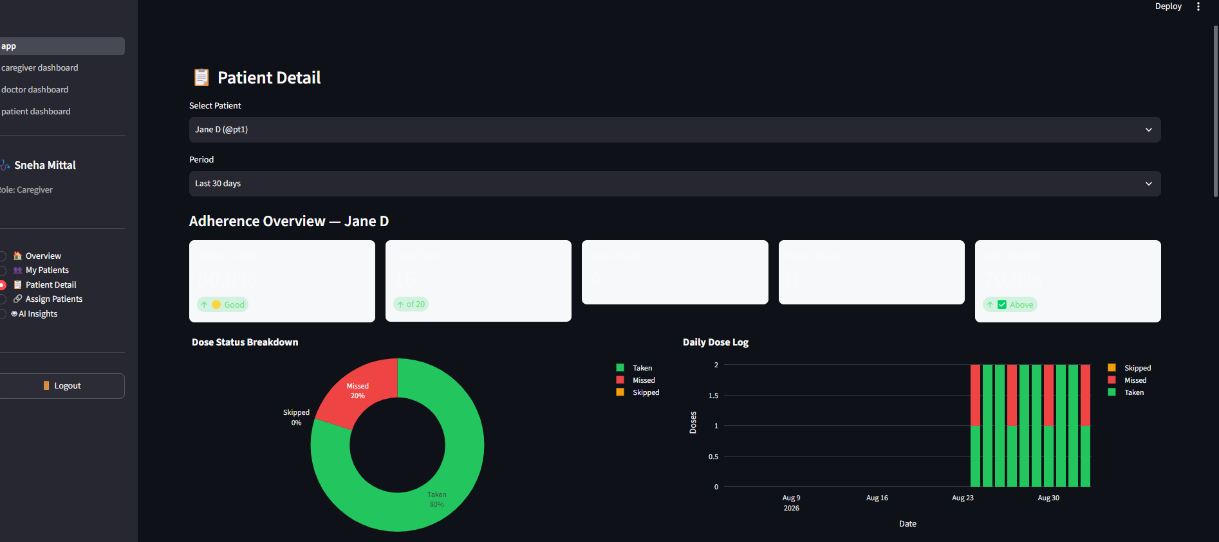
Result

Slide 11
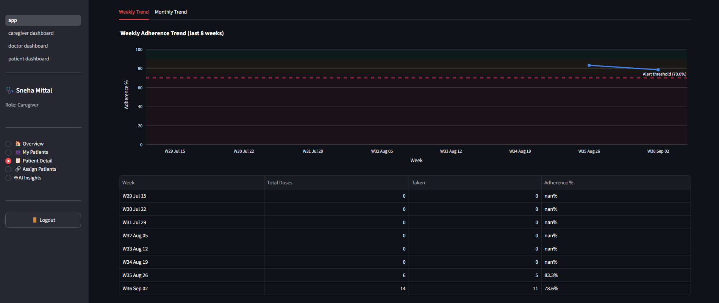
result

Slide 12
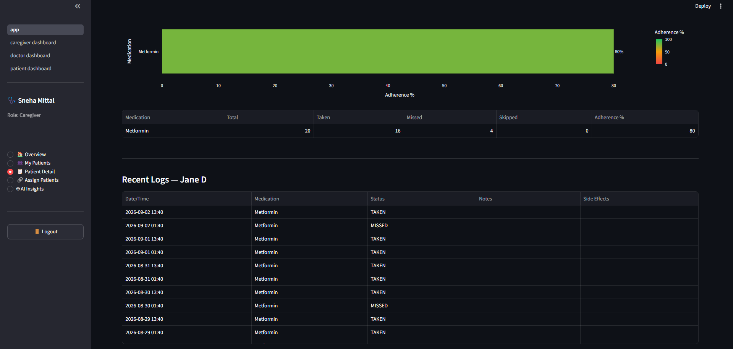
result

Slide 13
Conclusion
The proposed Medication Adherence Tracker for Chronic Patients aims to address the challenges faced by chronic disease patients in following their prescribed medication schedules. By integrating personalized medication reminders, dose confirmation, adherence tracking, and timely notifications, the system provides a practical and accessible approach to supporting medication adherence.
The system also improves communication between patients, caregivers, and healthcare providers by offering authorized access to medication-taking records and adherence reports. This visibility can help caregivers identify missed doses and enable healthcare professionals to recognize potential adherence concerns at an earlier stage.

Slide 14
Future scope
1.Smart Pillbox Integration
The system can be integrated with IoT-enabled smart pillboxes that detect when medication compartments are opened. This can provide additional evidence of medication-taking activity and reduce reliance solely on manual confirmation.
2. AI-Based Adherence Prediction
Machine learning algorithms can be incorporated to analyze medication history, missed-dose patterns, and patient behavior. The system could identify patients at higher risk of non-adherence and support early intervention.
3. Integration with Wearable Devices
Future versions may connect with smart watches and other wearable devices to monitor relevant health indicators, such as heart rate, blood pressure, or glucose levels, where supported. This could help provide a more comprehensive view of a patient's health management.
4. Integration with Electronic Health Records
The system could be connected with electronic health record platforms to allow authorized healthcare providers to access relevant medication information and adherence reports, reducing duplicate data entry and improving continuity of care.

Slide 15
References
AI Development Assistant: IBM, IBM Bob: AI-Powered Development Partner and Coding Agent, available at: https://bob.ibm.com
Google GenAI SDK Documentation: Google Developers, Google GenAI Python SDK and API Reference Guide, available at: https://aistudio.google.com/
Streamlit Documentation: Streamlit Inc., Streamlit Documentation: Building Web Apps in Python, available at: https://streamlit.io/
Python Software Foundation: Python Documentation — Python 3.x, available at: https://docs.python.org

Slide 16
Deployment link / github link
Github Link: https://github.com/mittalsneha102002-tech/Medication-Adherence-Tracker-for-Chronic-Patients.git

Slide 17
THANK YOU

